Slide 1
School in Kłomnice

Slide 2
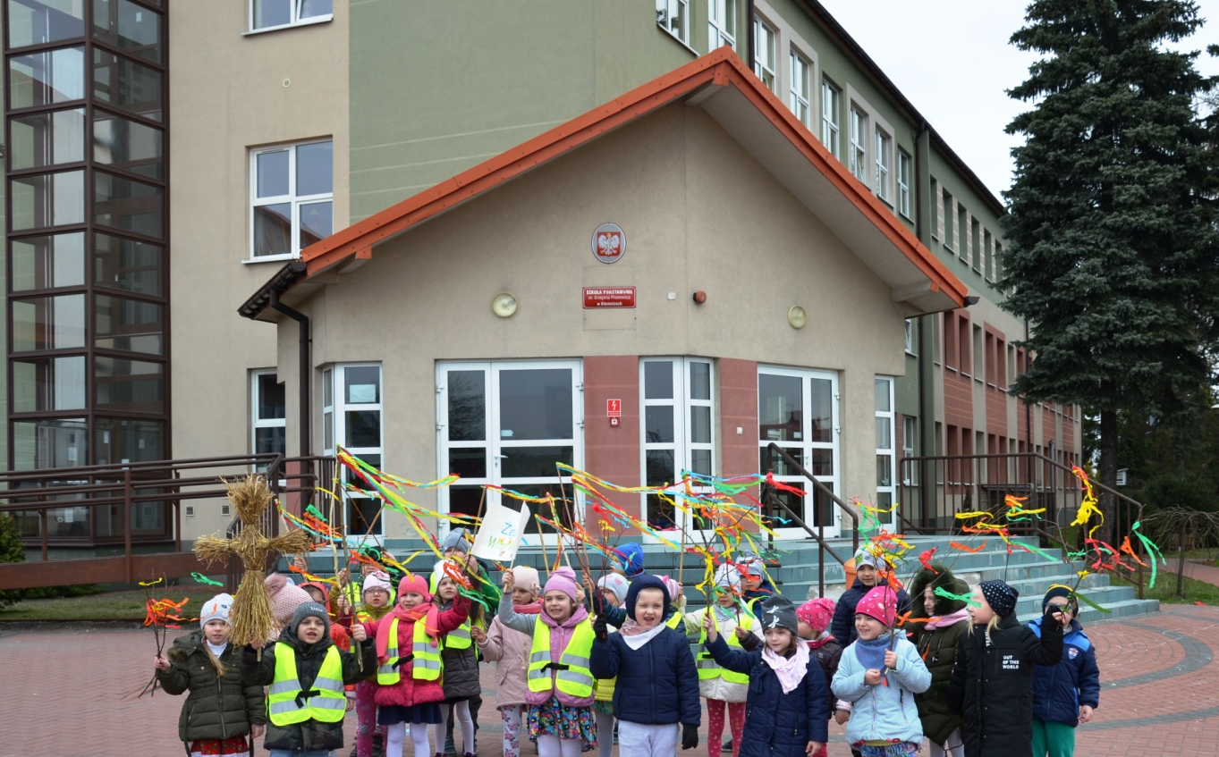
Our school is situated in the middle of our village , opposite the church The school is modern, well-equiped - it has two levels of education: preschool and primary, there are about 230 students aged 6-15 and about 40 teachers
.

Slide 3
Our school offers
1.Atmosphere favour to learning and developing interests, 2. Individual approach to the pupil, 3. Experienced and qualified pedagogic staff, 4. Guidance counselor, psychologist, speech therapist and supporting teachers, 5. Canteen, in which tasty meals are served ; 6. Fully equipped classrooms with modern facilities, e.g. interactive whiteboards, slide projectors; 7. Experimental chemistry lab, ICT labs, language labs; 8. Library with the reading room, in which computer positions are with the access to the Internet, 9. Sports hall with courts, 10. The running track and the court with the artificial surface for football, basketball, volleyball, handball; .

Slide 4
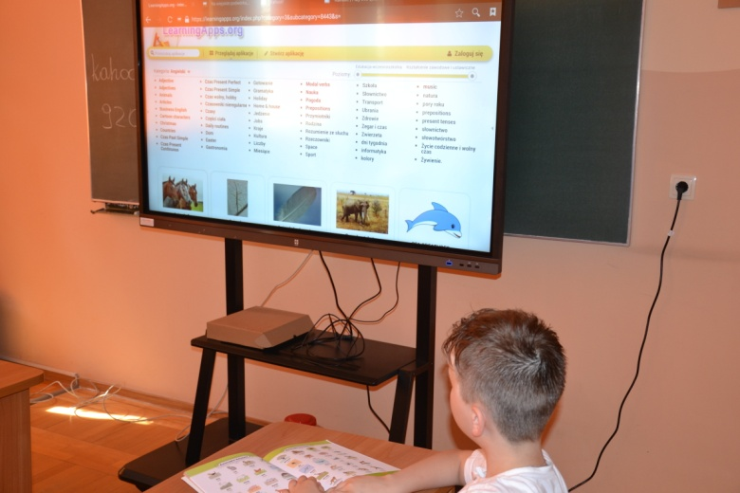
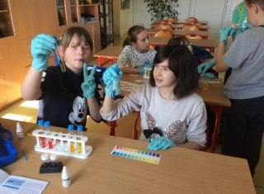
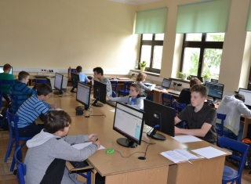
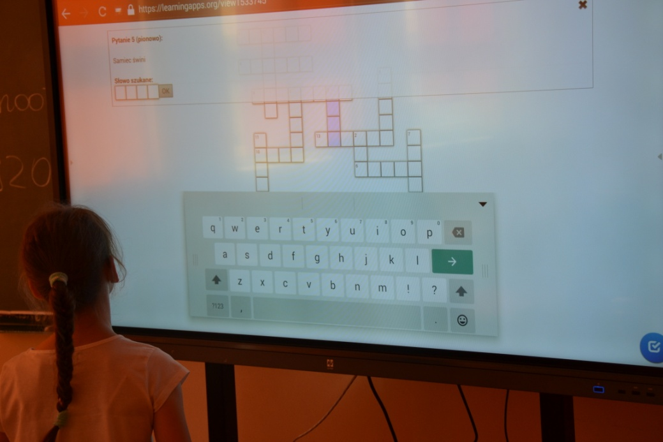
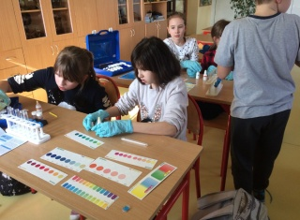

Slide 5
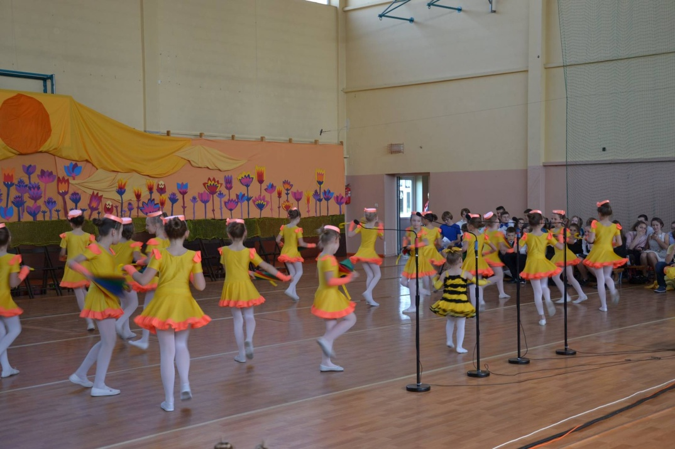
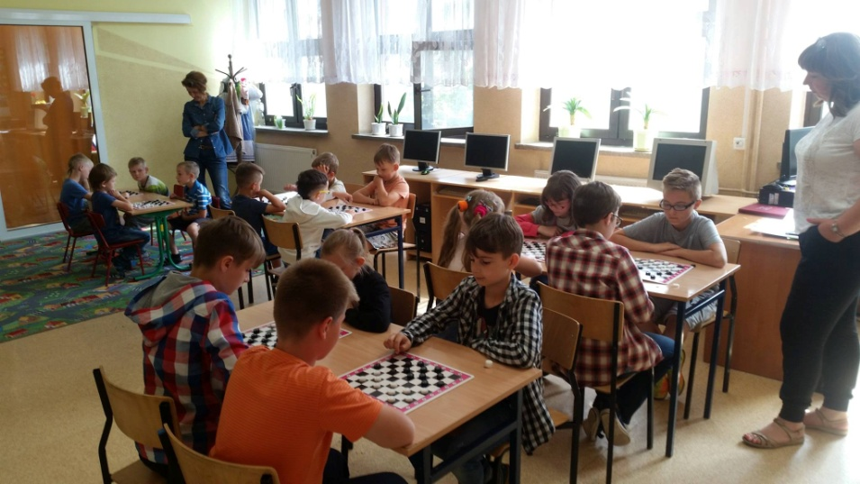
Our students can participate in different after-school activities such as : scouts group, sport classes, a choir, dance classes, cooking classes and many others.

Slide 6
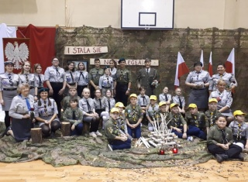
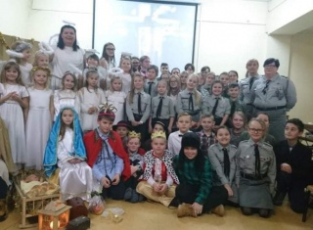
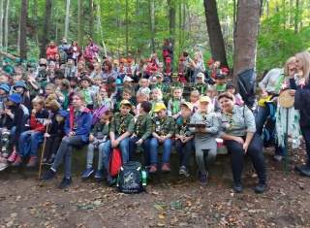
Our scouts

Slide 7
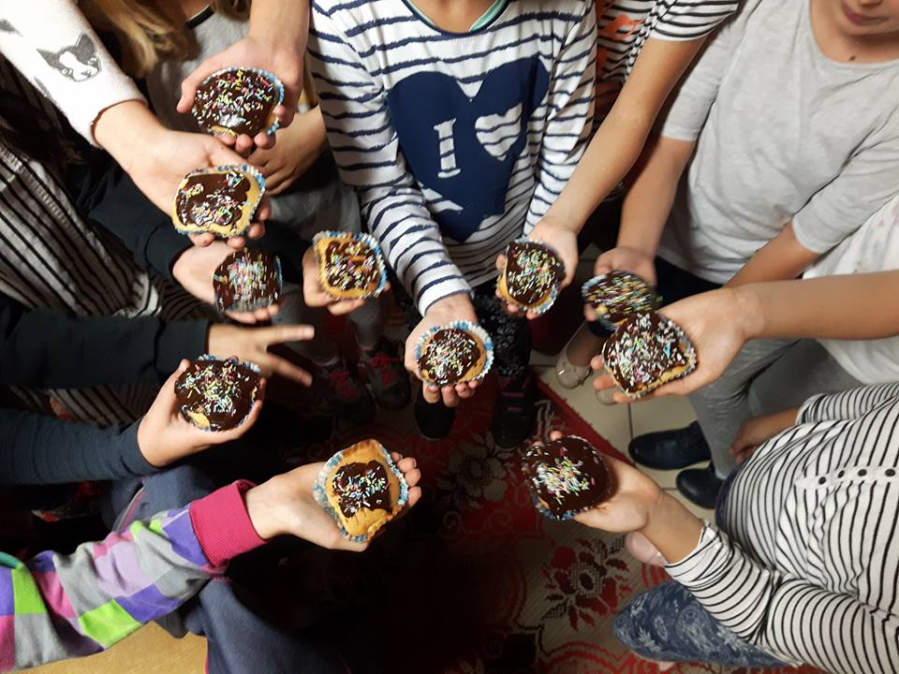
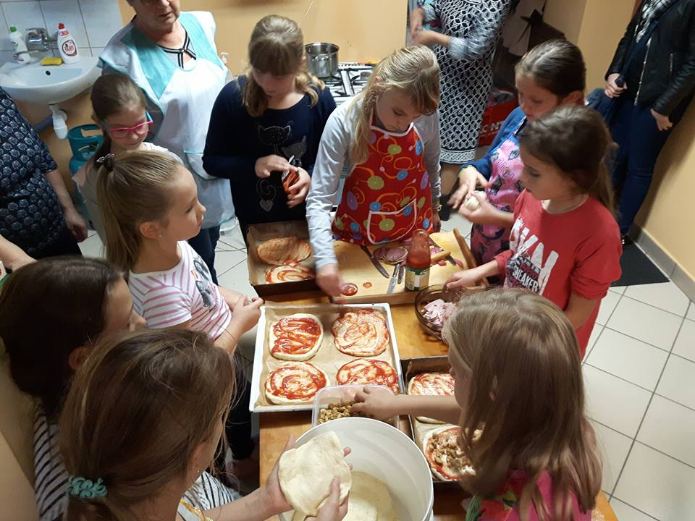
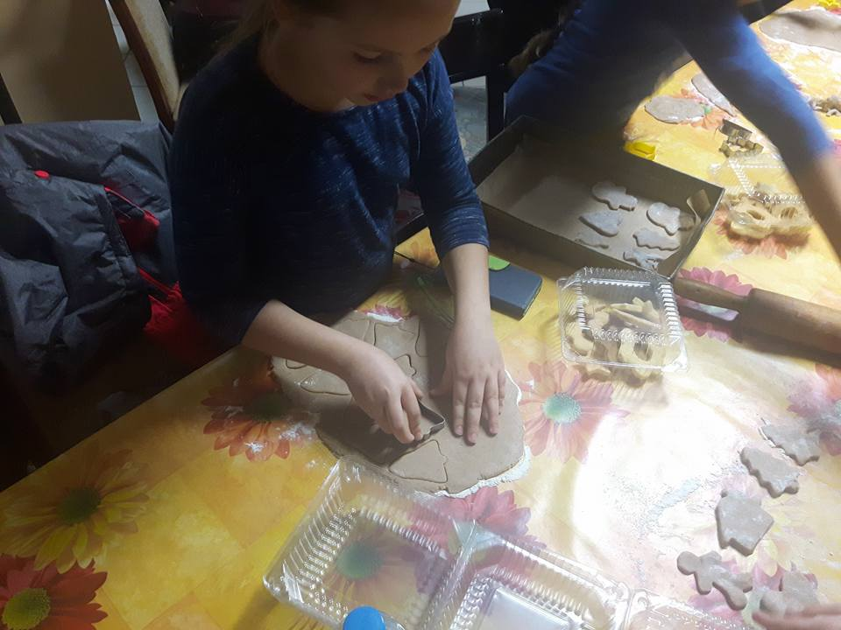
Cooking classes

Slide 8
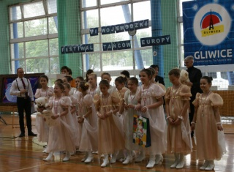
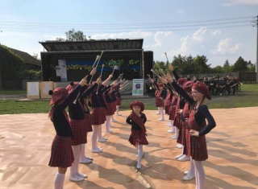
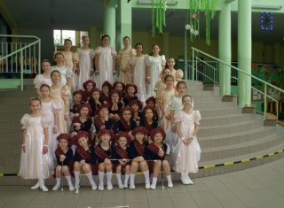
School majorettes

Slide 9
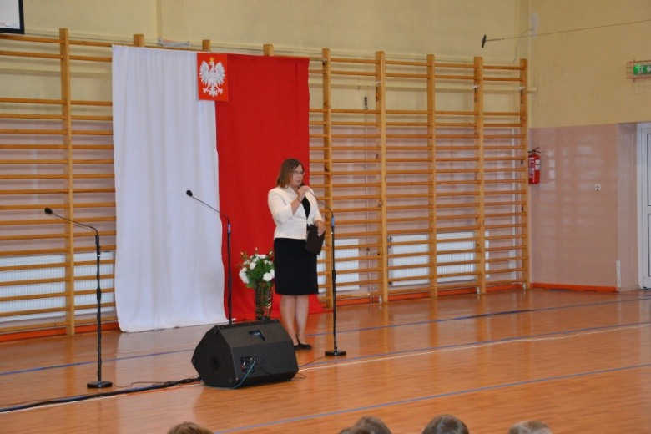
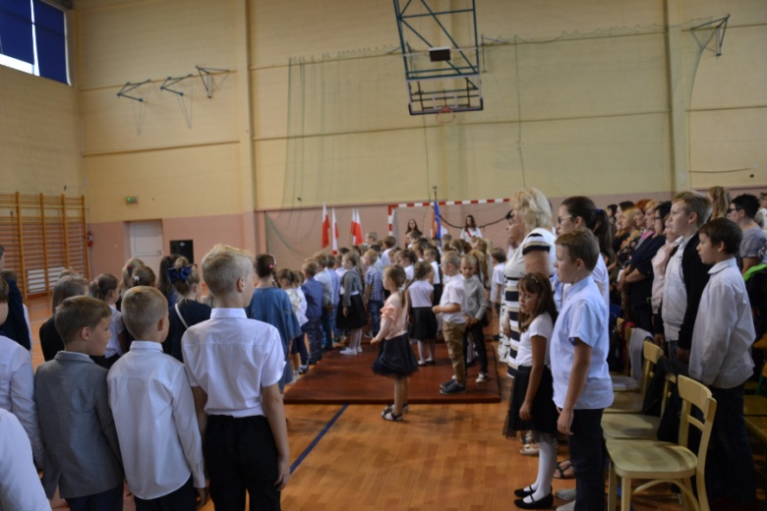
We often organize different sorts of fairs, charity events and school festivals.
The beginning of the school year and the school oath

Slide 10
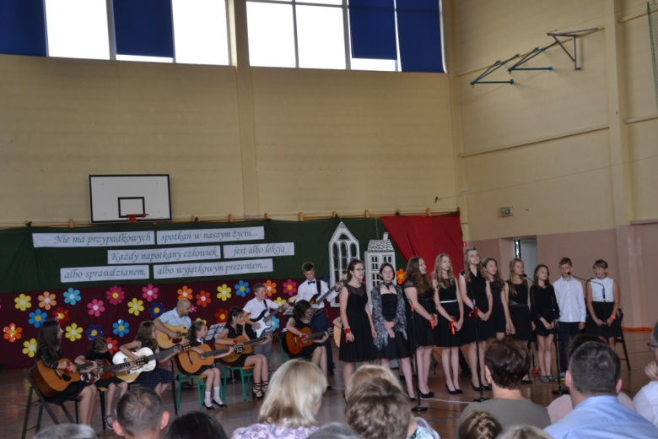
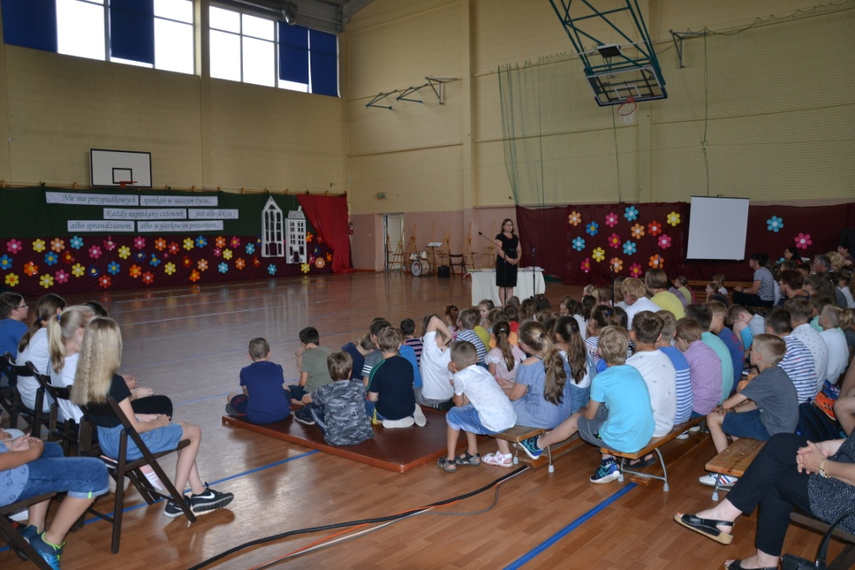
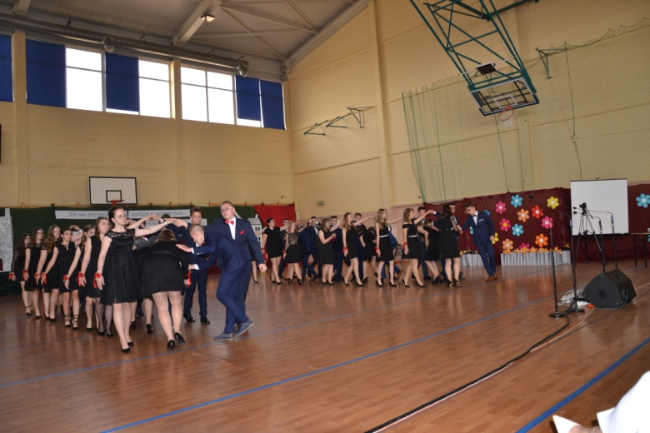
The end of the year.

Slide 11
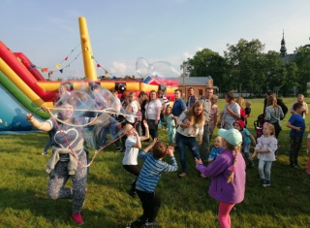
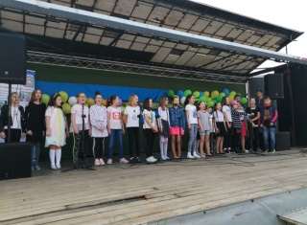
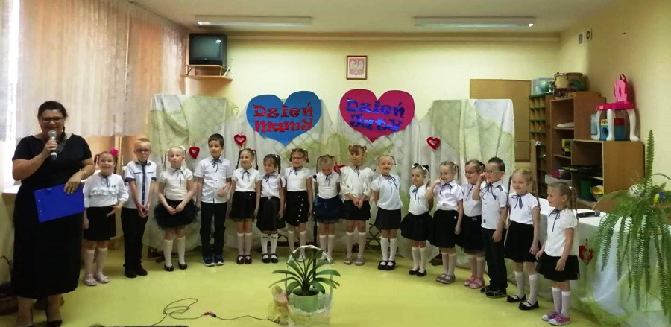
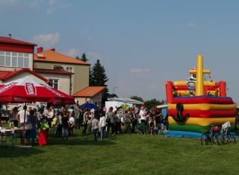
Mother’s Day fair, Children’s Day fair

Slide 12
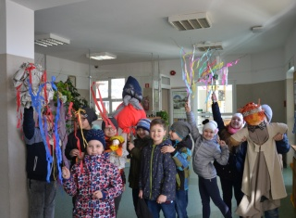
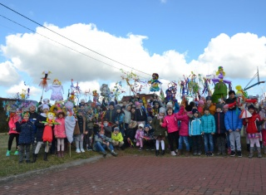
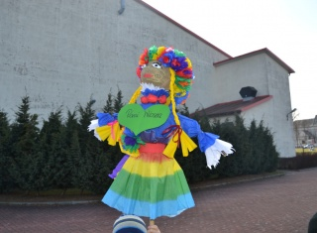
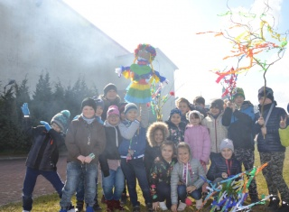
The beginning of spring

Slide 13
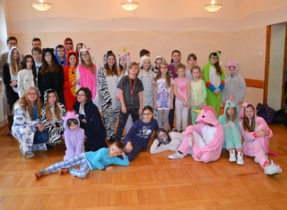
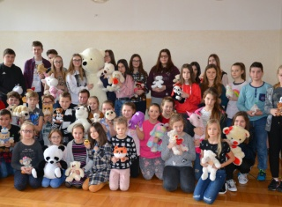
The pyjamas’day, the tedddy bear’s day

Slide 14
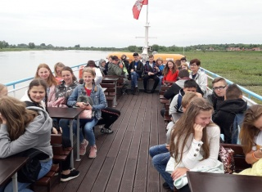
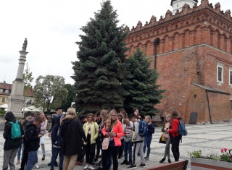
School trips
We go on many trips around Poland and last year we went to Prague. We visit fantastic, interesting, magical and beautiful places. We were in the mountains, by the lakes and many other places.

Slide 15
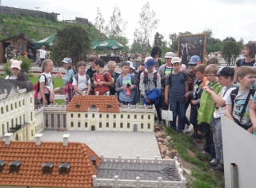
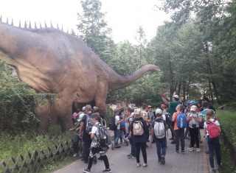
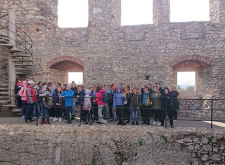
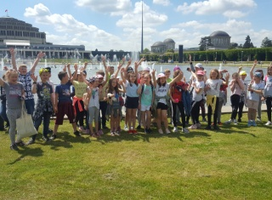
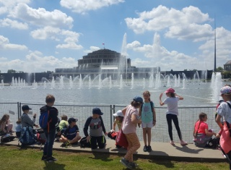
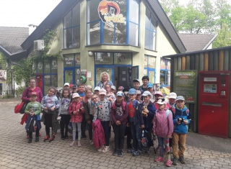

Slide 16
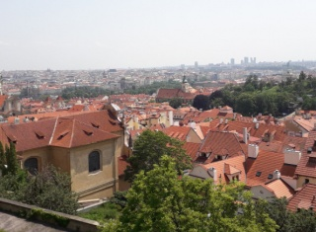
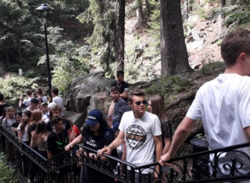
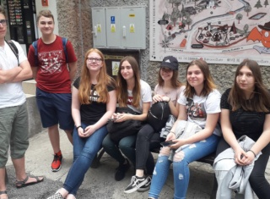
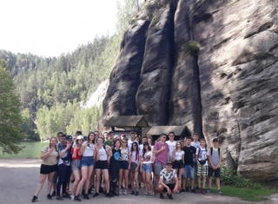
Prague and the Stone City

Slide 17
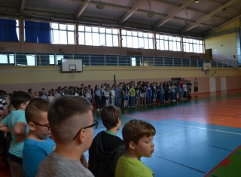
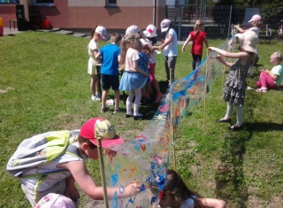
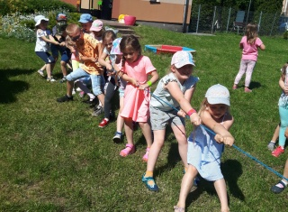
We have many sport competitions in volleyball and football between classes. During the first day of spring we have a sports day.

Slide 18
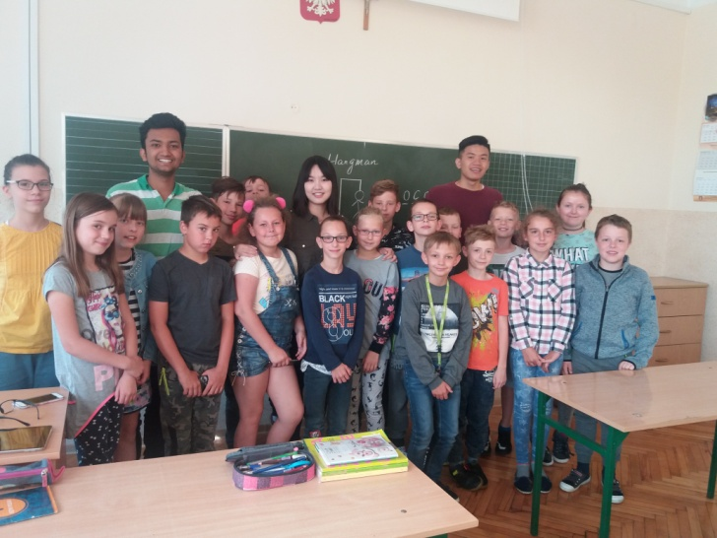
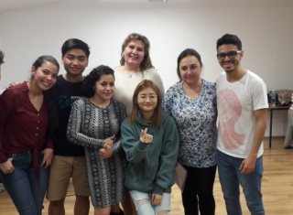
International cooperation
Last year we hosted the volunteers from India, China and Malaysia - they told students about the history, culture and customs of their countries.
This year the students took part in a laanguage camp – that was the opportunity to improve their English language.

Slide 19
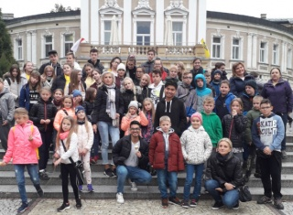
Our students also take part in e-twinning project. What do we get?
preparation for communication in English
connection and cooperation with the European schools with the use of electronic media.
cooperation over borders.

Slide 20
Thank you for your attention.
This presentation was made by : Agnieszka Kloczkowska, Katarzyna Biela , Maryla Piech.

