Slide 1
SEN students
Integration vs segregation
ESCOLA SECUNDÁRIA DE BARCELINHOS - Barcelos, Portugal
19 October 2023

Slide 3
from Including Students With Disabilities To Inclusive Education
Portugal Amends Its Education Law (2018)

Slide 4
The new flexible Curriculum is based on universal design for learning and a multilevel approach to access the curriculum.
This approach is based on:
flexible curricular models
systematic monitoring of the effectiveness of the continuum of implemented interventions
the dialogue between teachers with parents or caregivers
choice of measures to support learning, organized at different levels of intervention
educational responses necessary for each student to acquire a common base of competences, valuing their potential and interests.

Slide 5
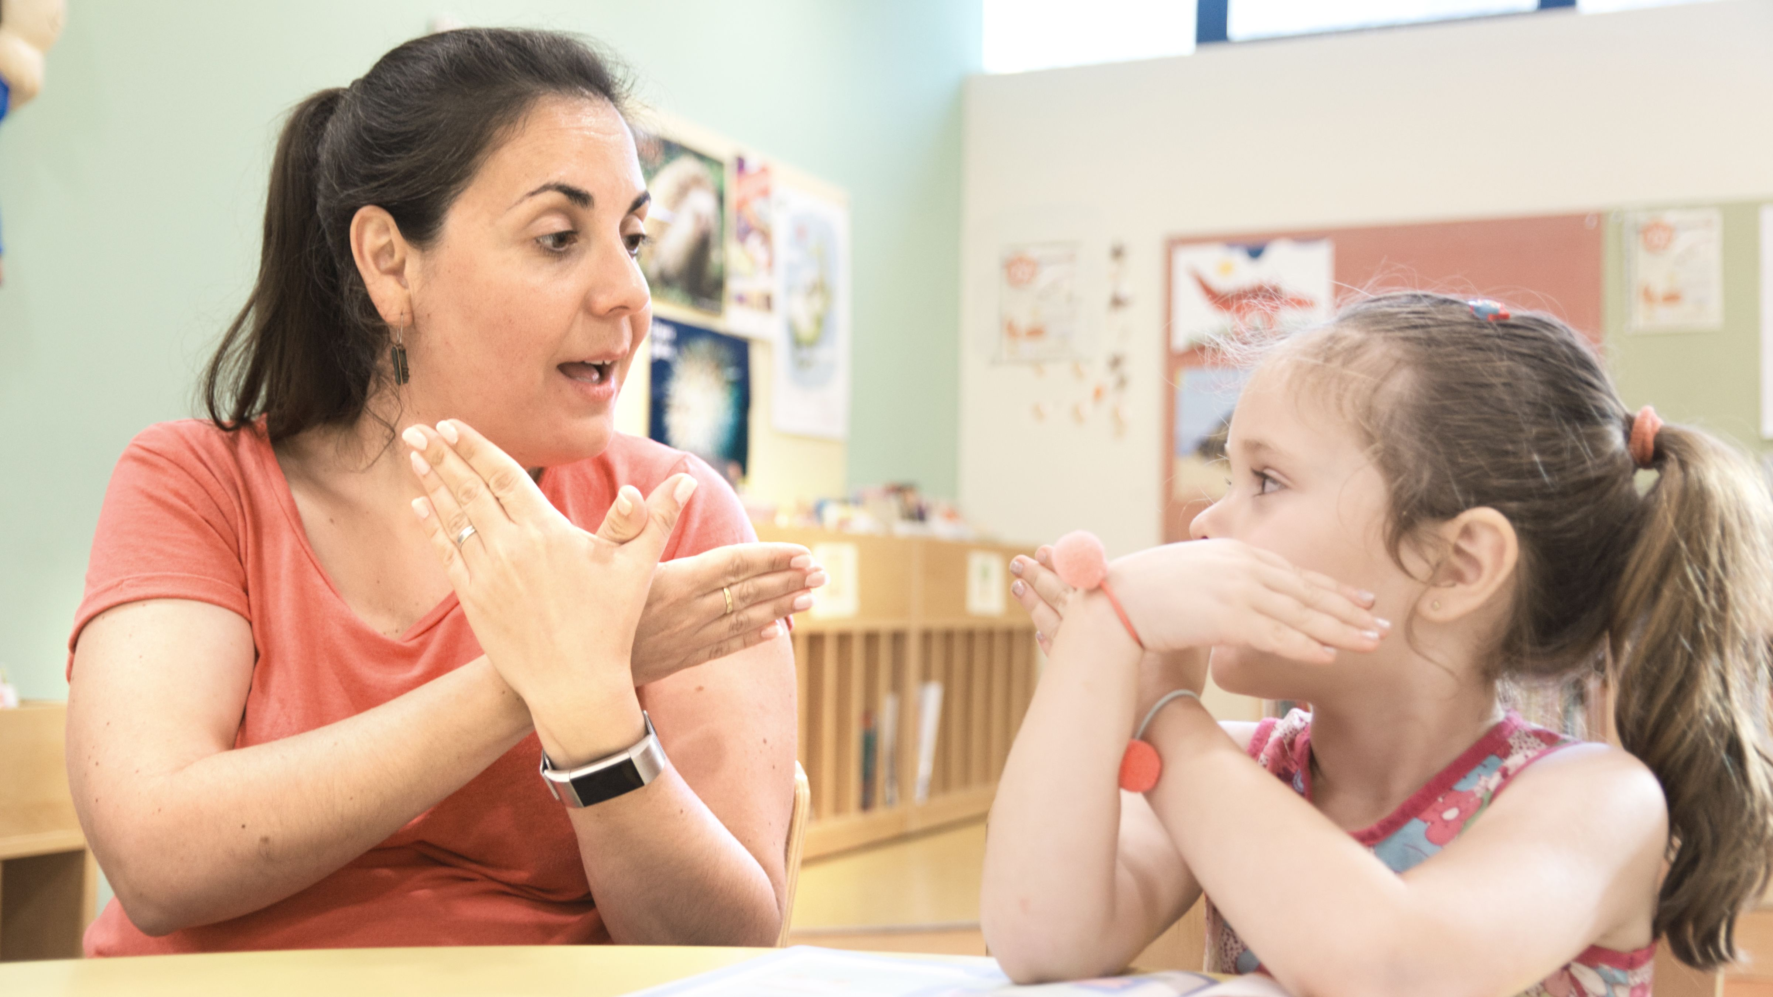
MAIN STEPS IN THIS PROCESS IN OUR SCHOOL:
We always try to detect and intervene as early as possible to remedy their difficulties (pre-school and primary school).
Students with specific needs, depending on their difficulties, can always be included in the regular classes with the other students and have support from the teachers of the subject
If necessary, they can have more specialized support from the Special Education Department (within the classroom or other therapies) until they improve.
Students with more profound difficulties go to institutions which continue to stimulate their abilities.

Slide 6
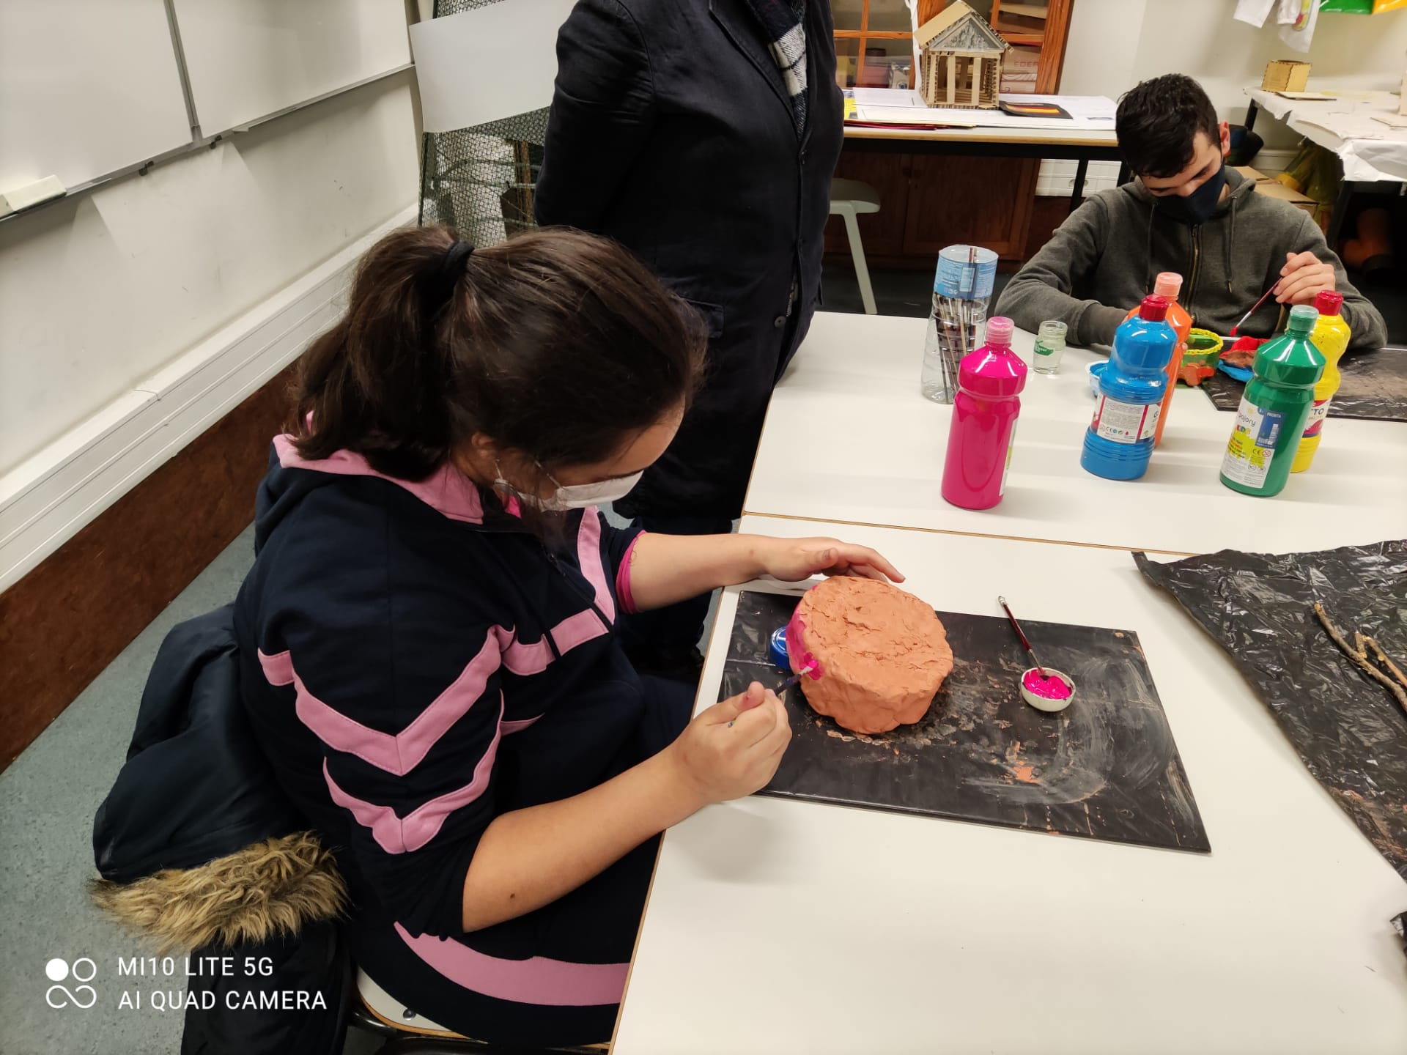
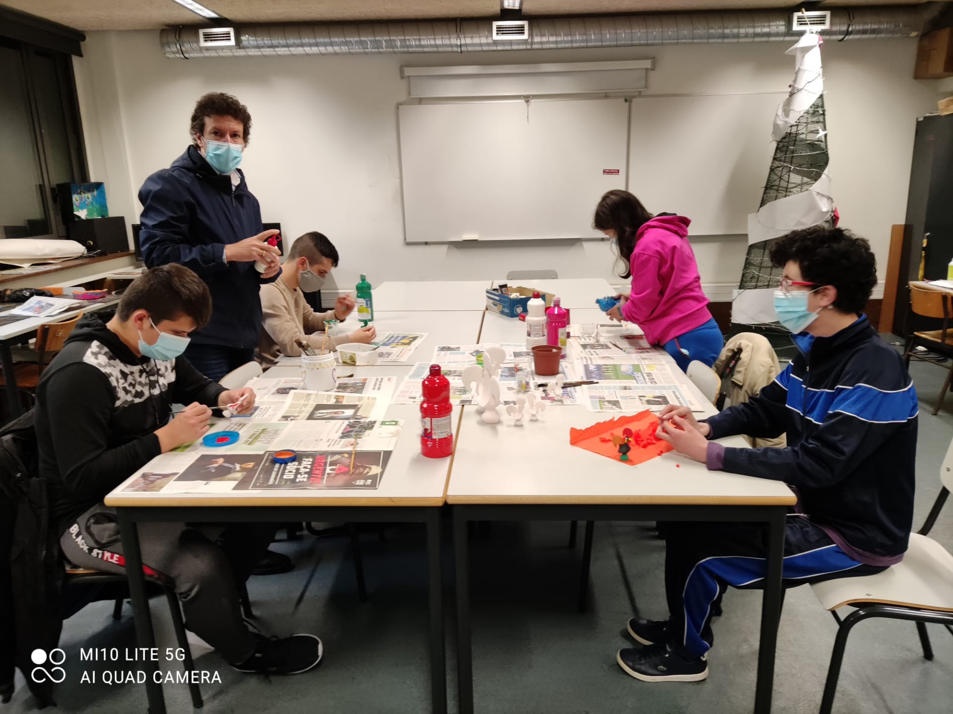
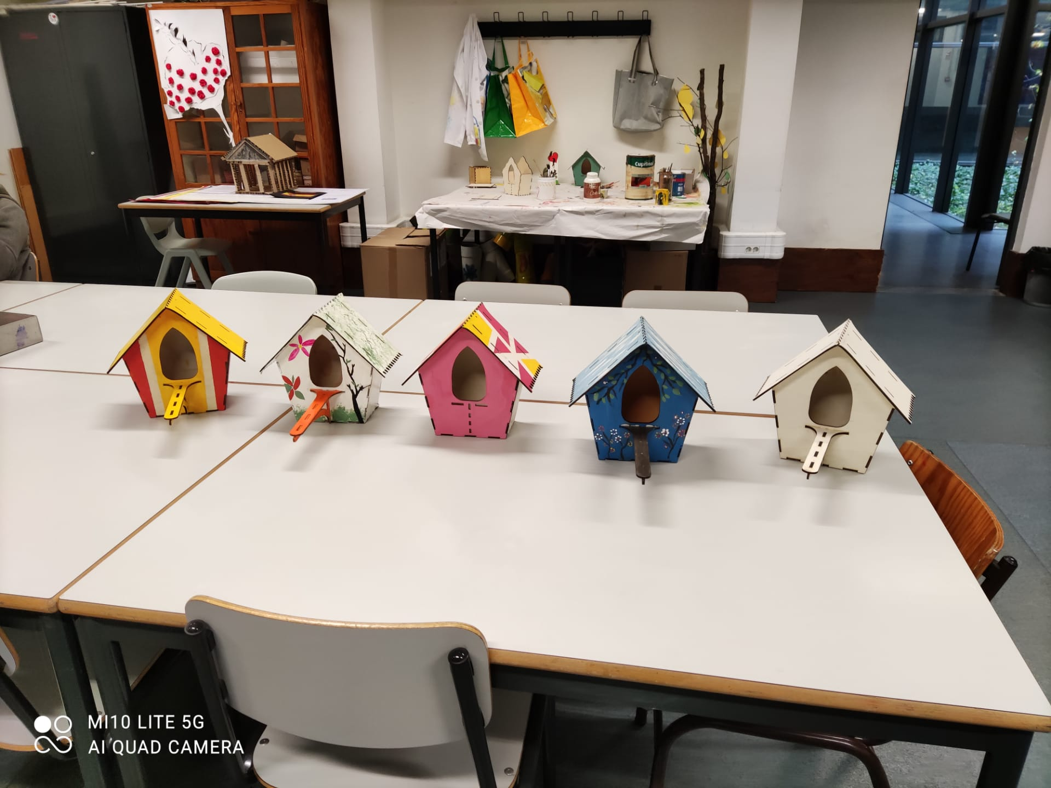
When the difficulties are more serious or profound, the students continue to be included in the class, but a specific program is designed for them, trying to meet their difficulties and that they feel equally integrated in the class.
Usually, the classes have a smaller number of students so that the teacher can give more attention and support to these students.

Slide 7
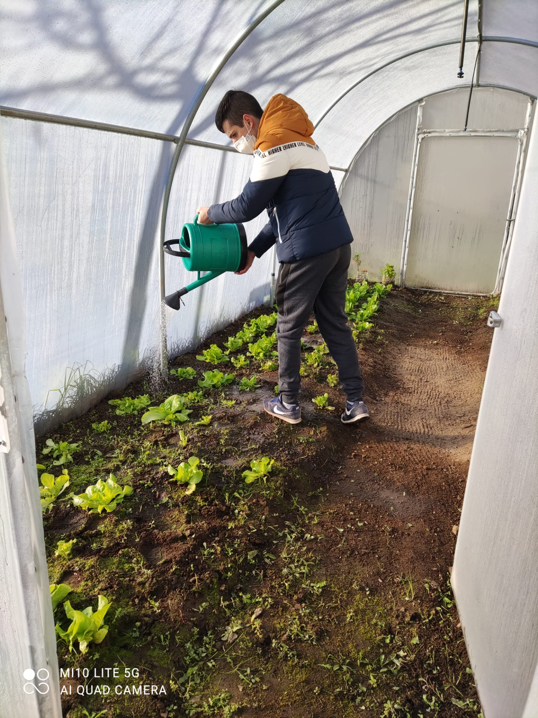
These students also have classes/learning activities outside the class, more specifically to work on activities of daily living and the development of personal and social autonomy skills in order to make them as autonomous as possible.
From the age of 15, students who have difficulties but can do practical work begin to be prepared through a Transition to Working Life Plan.

Slide 8
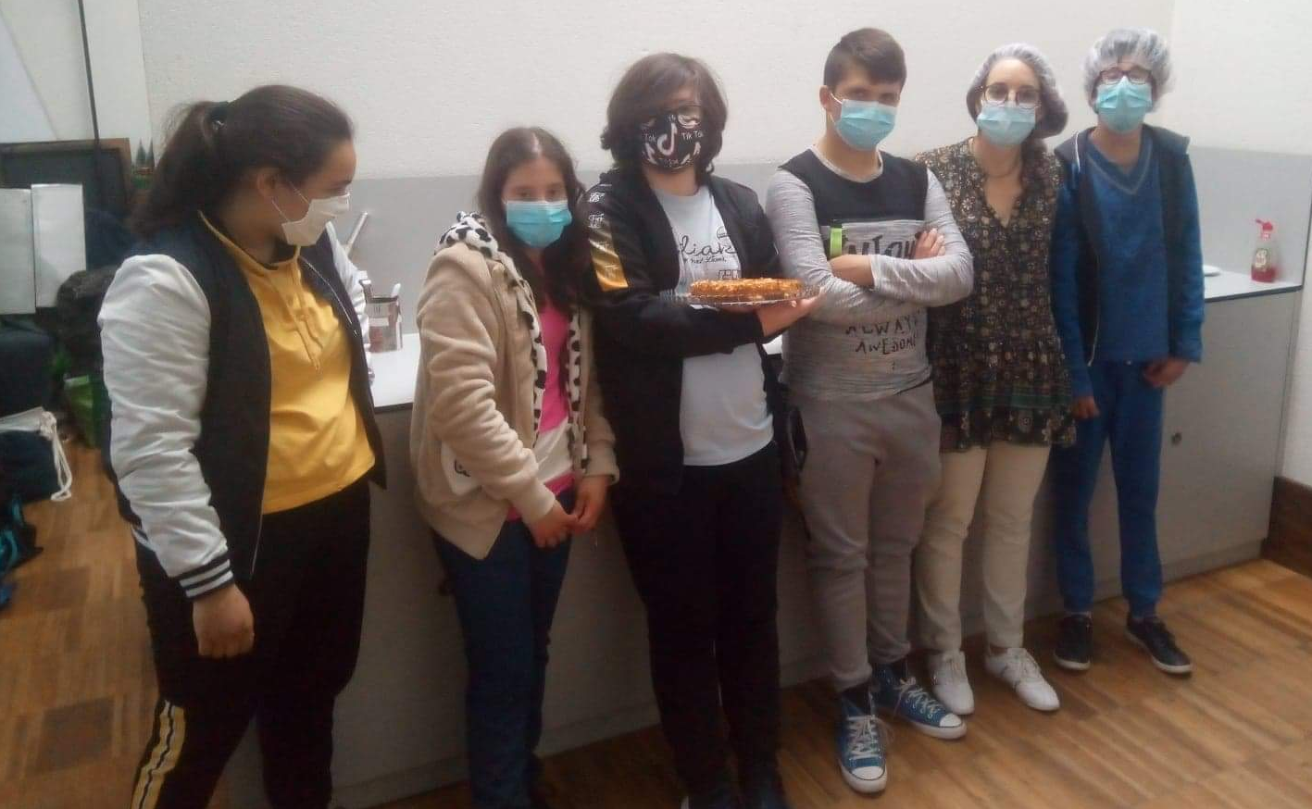
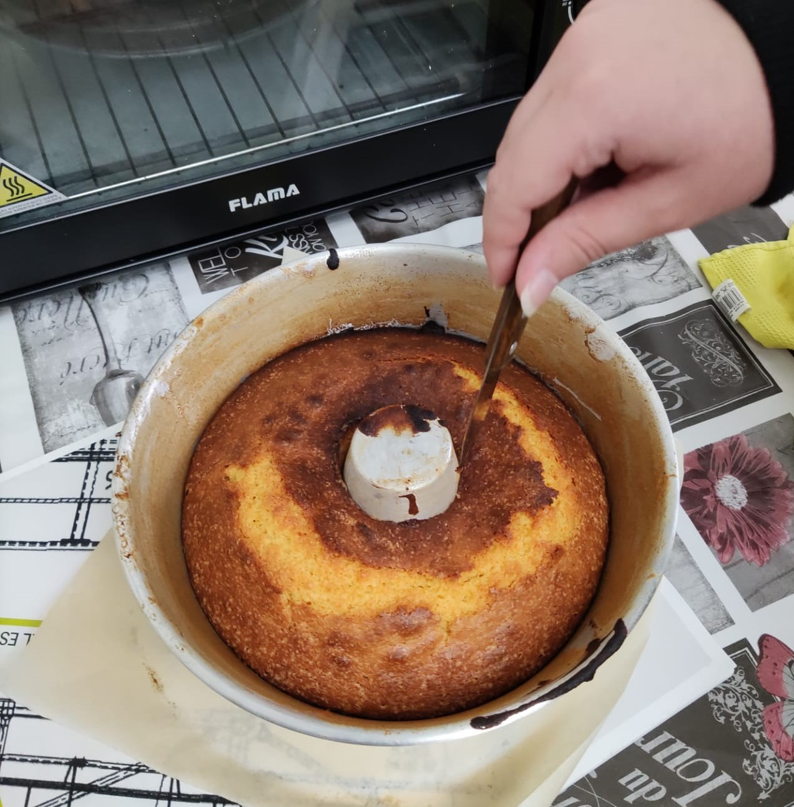
At this time, we also try to understand their skills and strong areas and integrate them one day a week in a community company doing work in that strong area. For example: mechanic, cook, pastry chef, gardener, hairdresser, etc.
In the 12th grade they finish school and can join the world of work or continue other practical training.
Students with more profound difficulties/disabilities go to institutions which continue to stimulate their abilities.

Slide 9
NO ONE SHOULD BE LEFT BEHIND

Slide 10
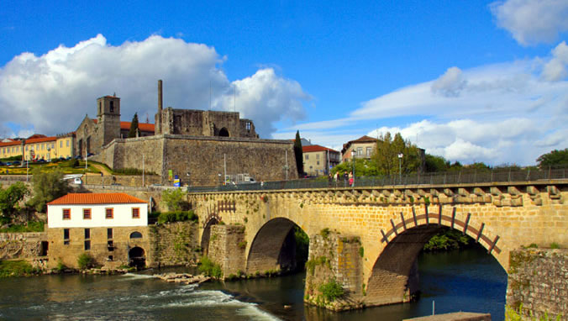
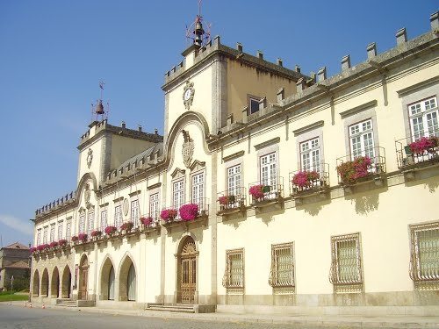
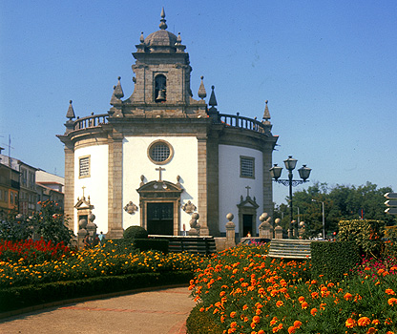
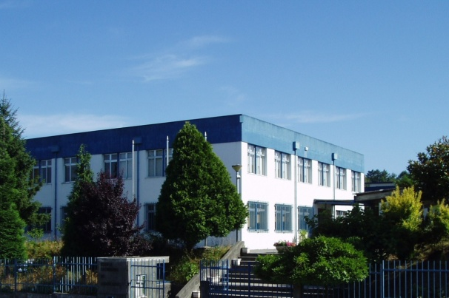
OBRIGADO.
Thank you.

Slide 11
Erasmus+ Team - Contacts
Rui Baptista
Paula Araújo
Erasmus+ Coordinator
Physics and Chemistry teacher
Robotics teacher
ruibaptista@esbarcelinhos.pt
English teacher (ESL)
paula.araujo@esbarcelinhos.pt
Carla Grande
Special Needs teacher
carla.grande@esbarcelinhos.pt

